Slide 1
College Technical Math 1
Section 10.2
Solving Systems of Two Variable Linear Equations - Addition

Slide 2
Solving Using Elimination(Addition)
“To eliminate” something means to remove it from a situation.
The elimination method (addition) is a method of solving a system of equations where we add the two equations together to eliminate one of the two variables from the system of equation.

Slide 3

Solving Using Elimination(Addition)
Before beginning the method of elimination the equations in the system need to be converted to standard form.
$$Ax+By=c$$

Slide 4
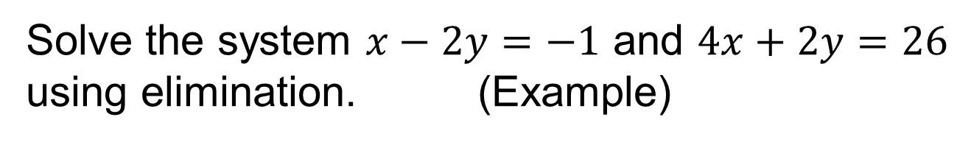
Solving Using Elimination(Addition)
Solve the system $x−2y=−1$ and $4x+2y=26$ using elimination. (Example)

Slide 5


Solving Using Elimination(Addition)
Solve the system $x−2y=−1$ and $4x+2y=26$ using elimination. (Example)
$$x−2y=−1$$
Both equations are already in standard form.
$$4x+2y=26$$

Slide 6
Solving Using Elimination(Addition)
Solve the system $x−2y=−1$ and $4x+2y=26$ using elimination. (Example)
$$x−2y=−1$$
We now need to chose a variable to eliminate.
$$4x+2y=26$$

Slide 7
Solving Using Elimination(Addition)
Solve the system $x−2y=−1$ and $4x+2y=26$ using elimination. (Example)
$$x−2y=−1$$
Always check to see if one of the variables will be “naturally” eliminated.
$$4x+2y=26$$
These two terms do not eliminate the x terms when added.
These two terms do eliminate the y terms when added.

Slide 8



Solving Using Elimination(Addition)
Solve the system $x−2y=−1$ and $4x+2y=26$ using elimination. (Example)
$$x−2y=−1$$
Since the y terms “naturally” eliminate themselves, we add the two equations together.
$$4x+2y=26$$
$$5x$$
$$=25$$
$$x=5$$

Slide 9

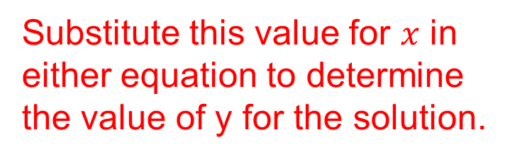




Solving Using Elimination(Addition)
Solve the system $x−2y=−1$ and $4x+2y=26$ using elimination. (Example)
$$x=5$$
Substitute this value for $x$ in either equation to determine the value of y for the solution.
$$4\left(5\right)+2y=26$$
$$20+2y=26$$
$$2y=6$$
$$y=3$$

Slide 10
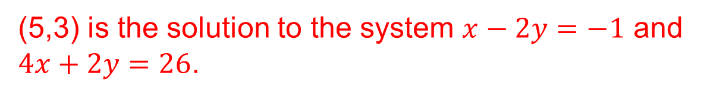
Solving Using Elimination(Addition)
Solve the system $x−2y=−1$ and $4x+2y=26$ using elimination. (Example)
(5,3) is the solution to the system $x−2y=−1$ and $4x+2y=26$.

Slide 11
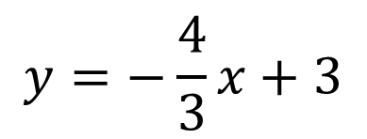
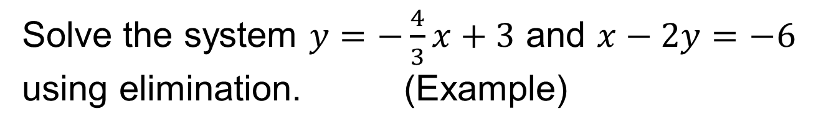


Solving Using Elimination(Addition)
Solve the system $y=−\frac{4}{3}x+3$ and $x−2y=−6$ using elimination. (Example)
$$y=−\frac{4}{3}x+3$$
The first equation is not in standard form. Before proceeding, we need to convert this equation to standard form.
$$3y=−4x+9$$
$$4x+3y=9$$

Slide 12


Solving Using Elimination(Addition)
Solve the system $y=−\frac{4}{3}x+3$ and $x−2y=−6$ using elimination. (Example)
$$4x+3y=9$$
Check to see if one of the variables will be “naturally” eliminated.
$$x−2y=−6$$
NO!
NO!

Slide 13
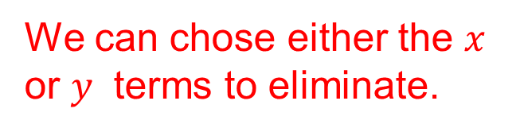
Solving Using Elimination(Addition)
Solve the system $y=−\frac{4}{3}x+3$ and $x−2y=−6$ using elimination. (Example)
$$4x+3y=9$$
We can chose either the $x$ or $y$ terms to eliminate.
$$x−2y=−6$$

Slide 14
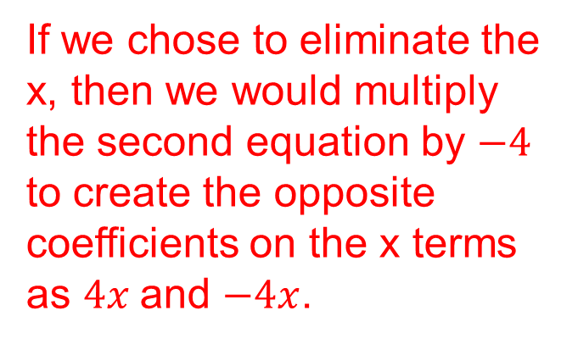
Solving Using Elimination(Addition)
Solve the system $y=−\frac{4}{3}x+3$ and $x−2y=−6$ using elimination. (Example)
$$4x+3y=9$$
If we chose to eliminate the x, then we would multiply the second equation by $−4$ to create the opposite coefficients on the x terms as $4x$and $−4x$.
$$x−2y=−6$$

Slide 15
Solving Using Elimination(Addition)
Solve the system $y=−\frac{4}{3}x+3$ and $x−2y=−6$ using elimination. (Example)
$$4x+3y=9 4x+3y=9$$
$$−4\left(x−2y=−6\right) −4x+8y=24$$

Slide 16
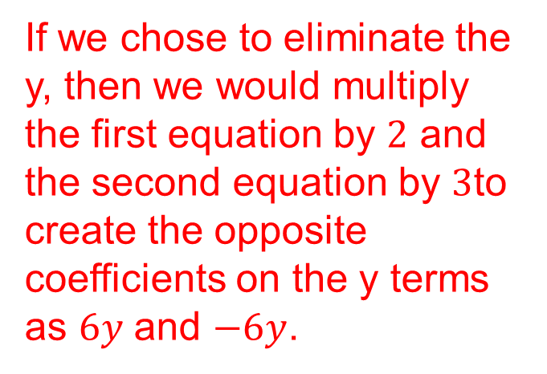
Solving Using Elimination(Addition)
Solve the system $y=−\frac{4}{3}x+3$ and $x−2y=−6$ using elimination. (Example)
$$4x+3y=9$$
If we chose to eliminate the y, then we would multiply the first equation by $2$ and the second equation by $3$to create the opposite coefficients on the y terms as $6y$ and $−6y$.
$$x−2y=−6$$

Slide 17
Solving Using Elimination(Addition)
Solve the system $y=−\frac{4}{3}x+3$ and $x−2y=−6$ using elimination. (Example)
$$2\left(4x+3y=9\right) 8x+6y=18$$
$$3\left(x−2y=−6\right) 3x−6y=−18$$
It doesn’t matter which variable we eliminate from the system of equations. Let’s choose y.

Slide 18


Solving Using Elimination(Addition)
Solve the system $y=−\frac{4}{3}x+3$ and $x−2y=−6$ using elimination. (Example)
$$2\left(4x+3y=9\right) 8x+6y=18$$
$$3\left(x−2y=−6\right) 3x−6y=−18$$
$$11x =0$$
$$x=0$$

Slide 19


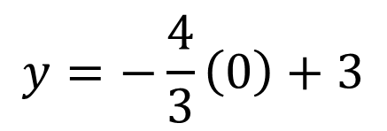
Solving Using Elimination(Addition)
Solve the system $y=−\frac{4}{3}x+3$ and $x−2y=−6$ using elimination. (Example)
$$x=0$$
$$y=−\frac{4}{3}\left(0\right)+3$$
$$y=3$$

Slide 20
Solving Using Elimination(Addition)
Solve the system $y=−\frac{4}{3}x+3$ and $x−2y=−6$ using elimination. (Example)
(0,3) is the solution to this system of equations.

